Slide 1
Direct vs Regular Mutual Fund Plans
By Gopalakrishnan Kumar, MTech IIT-Bombay,
Freelance Data Science Consultant
LinkedIn: Profile Link : https://www.linkedin.com/in/gopalakrishnankumar-a73301110/
Github:https://github.com/Gopal21236/
Kaggle URL- https://www.kaggle.com/gopalkk2

Slide 2
Google Colab URL
https://colab.research.google.com/drive/1x-kCs8oXtlB3VDHvNS8xDSQeWL9znQZ5?usp=sharing

Slide 3
Introduction
Mutual fund investors in India can choose between Direct plans and Regular plans. While both invest in the same underlying portfolio, they differ mainly in expense ratio, which has a significant long-term impact on returns due to compounding.
This report presents a simulation-based analysis comparing Direct and Regular mutual fund plans, focusing on:
Expense ratio impact
Long-term compounding effects
Break-even analysis
Investor decision implications

Slide 4
Understanding Direct vs Regular Plans
2.1 Regular Plan
Purchased through distributors or advisors
Includes distributor commission
Higher expense ratio
Lower NAV compared to Direct plan
2.2 Direct Plan
Purchased directly from AMC or online platforms
No distributor commission
Lower expense ratio
Higher NAV for the same fund
The only structural difference between the two plans is the expense ratio.

Slide 5
Simulation Assumptions
Category | Parameter | Assumption / Value
Investment Type | Mode | Lump sum
 | Initial Investment | ₹1,00,000
Investment Horizon | Time Period | 30 years
Market Return | Gross Annual Return | 12%
Expense Ratio | Regular Plan | 2.0%
 | Direct Plan | 1.0%
Net Return | Regular Plan | 10% (12% − 2%)
 | Direct Plan | 11% (12% − 1%)
Compounding | Frequency | Annual
Taxation | Capital Gains Tax | Ignored (same for both plans)
Risk Modeling | Market Volatility | Not considered
Advisory Value | Behavioral / Advisory Impact | Not quantified
Objective | Analysis Focus | Expense ratio & compounding impact
The gross return is assumed to be identical for both plans since the underlying portfolio is the same.

Slide 6
Methodology
The future value of the investment is calculated using compound interest:
Future Value = Principal × (1 + Net Return)^Years
Where:
Net Return = Gross Return – Expense Ratio
Separate simulations are run for Direct and Regular plans, and the annual difference in corpus is computed.

Slide 7
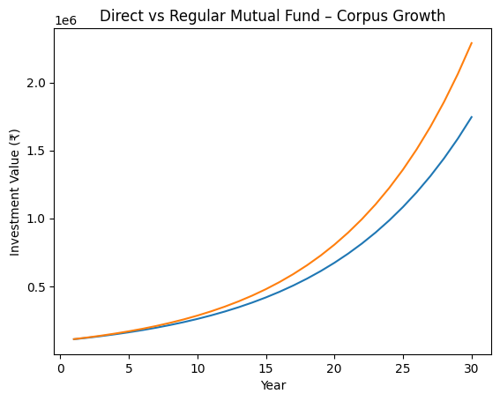
Data Visualization

Slide 8
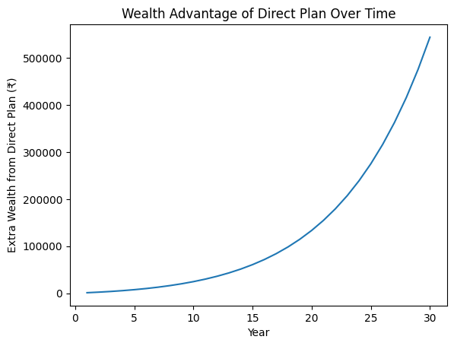
Data Visualization

Slide 9
Long-Term Compounding Results
5.1 Corpus Growth Comparison
After 30 years:
Regular Plan Value: ~₹17.4 lakh
Direct Plan Value: ~₹22.9 lakh
5.2 Wealth Difference
Additional wealth from Direct Plan: ~₹5.5 lakh
This represents over 30% higher corpus compared to the Regular plan
The gap widens exponentially over time due to compounding.

Slide 10
Expense Ratio Impact Analysis
Even a seemingly small difference of 1% in expense ratio leads to a substantial erosion of wealth over long investment horizons.
Key observations:
Expense ratio is deducted daily from NAV
Investors never see this cost explicitly
Costs compound negatively year after year
Over 30 years, the cumulative effect of higher expenses becomes larger than the original investment amount.

Slide 11
Break-even Analysis
The break-even point is defined as the year when the Direct plan corpus exceeds the Regular plan corpus.
Result:
Break-even Year: Year 1
Since the expense ratio difference applies from the beginning, the Direct plan outperforms the Regular plan from the very first year.
There is no time horizon where the Regular plan provides a higher return purely on a return basis.

Slide 12
Investor Perspective Analysis
8.1 When Direct Plans Are Ideal
Investors comfortable with online platforms
Long-term wealth creators
Cost-conscious investors
Passive or index fund investors
8.2 When Regular Plans May Be Justified
Investors needing behavioral coaching
First-time investors requiring guidance
Situations where advisors add value through asset allocation, tax planning, or discipline
The additional cost of a Regular plan should be weighed against the actual value provided by the advisor.

Slide 13
Risk and Behavioral Considerations
While Direct plans offer higher returns, investor behavior plays a crucial role:
Poor timing decisions can negate cost advantages
Panic selling during market corrections can reduce returns
An advisor who prevents such mistakes may justify their fee for certain investors.

Slide 14
Key Takeaways
Expense ratio is the only guaranteed cost in mutual fund investing
A 1% difference can reduce long-term wealth by 30% or more
Direct plans are mathematically superior for long-term investors
Regular plans are suitable only if advisory value exceeds cost

Slide 15
Conclusion
This simulation clearly demonstrates that Direct mutual fund plans create significantly higher long-term wealth compared to Regular plans due to lower expense ratios. The power of compounding works both ways—positively for returns and negatively for costs.
For disciplined, informed investors, Direct plans are the optimal choice. However, investors who benefit from professional guidance should carefully evaluate whether the advisory support justifies the additional expense.

Slide 16
Scope for Further Analysis
SIP-based simulation
Variable expense ratios across fund categories
Advisor fee vs Regular plan comparison
Tax-adjusted return analysis
Power BI / Excel interactive dashboard

